Slide 1
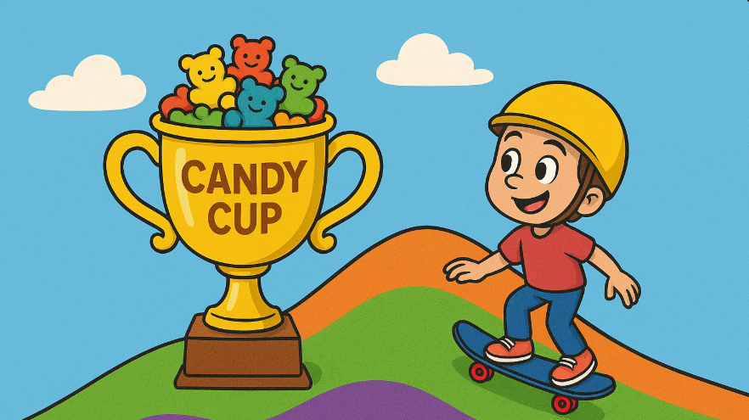
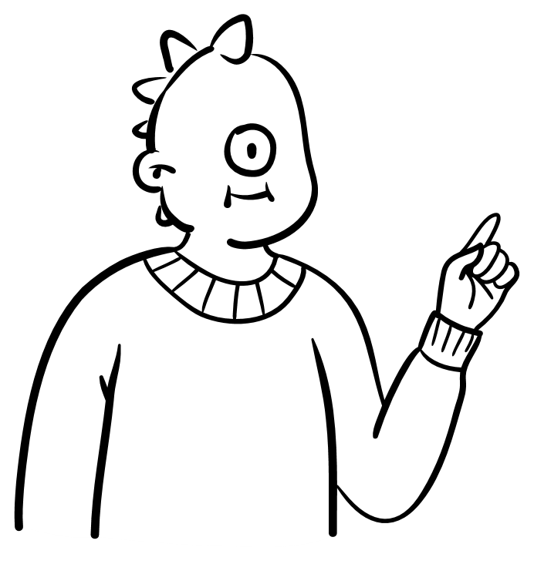
Downhill Dash: Gradient Descent Explained!
John Castor ITAI 2376

Slide 2
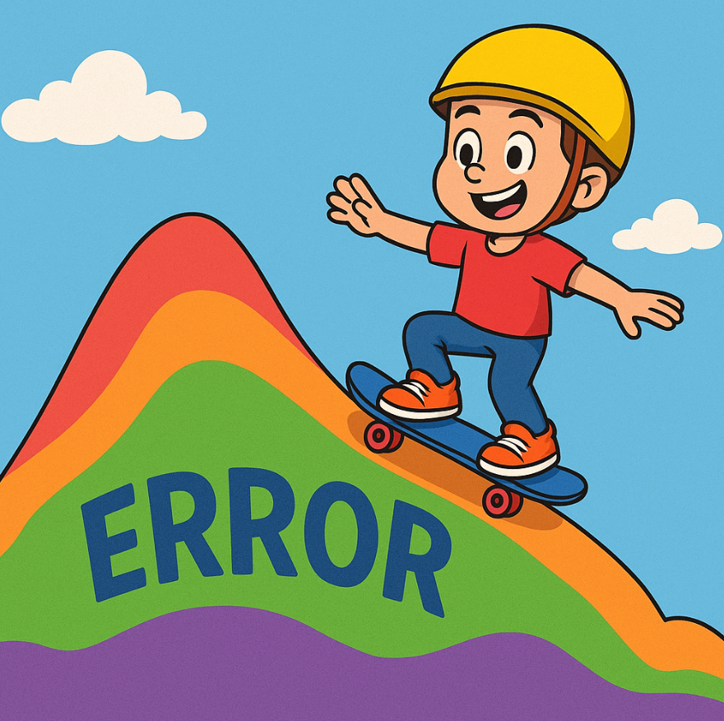
Meet Skater Sam
Imagine every answer a computer gives sitting on a colorful hill of mistakes.
Big bumps mean the computer is way off, tiny dips mean it's close to right.
Sam is our skateboard hero exploring this hill.

Slide 3
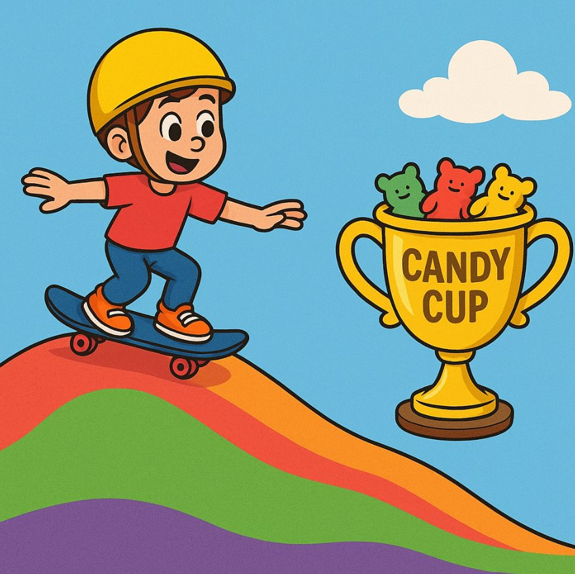
Goal: the Candy Cup!
The very lowest point on the hill is where the computer’s mistake is almost zero. Training is like guiding Sam to that exact spot so the computer can be as correct as possible. For example; A shiny Candy Cup filled with gummy bears waits at the lowest dip, and Sam wins only when he stops right there.

Slide 4
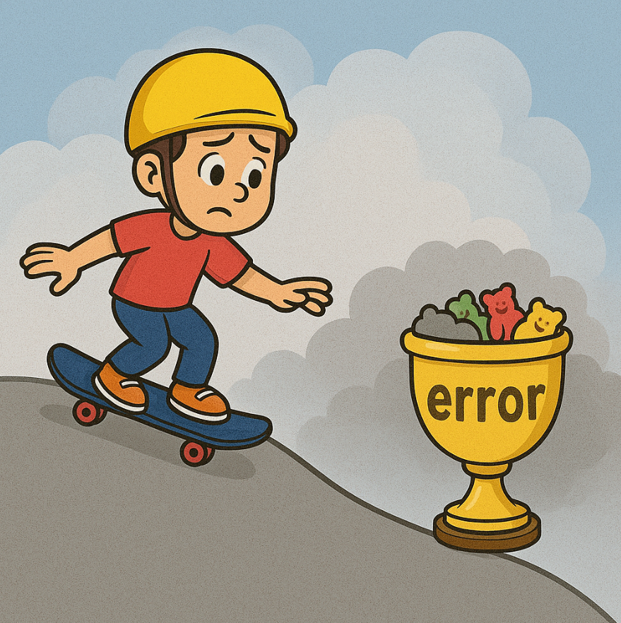
Foggy View
Sam-and computers-can't see the whole hill at once because it’s covered in thick fog. They only know whether the ground tilts up or down right under their feet, one step at a time. Think about it this way; Sam rolls slowly, feeling the slope with his wheels, just like a computer checks its mistake in its current position.

Slide 5
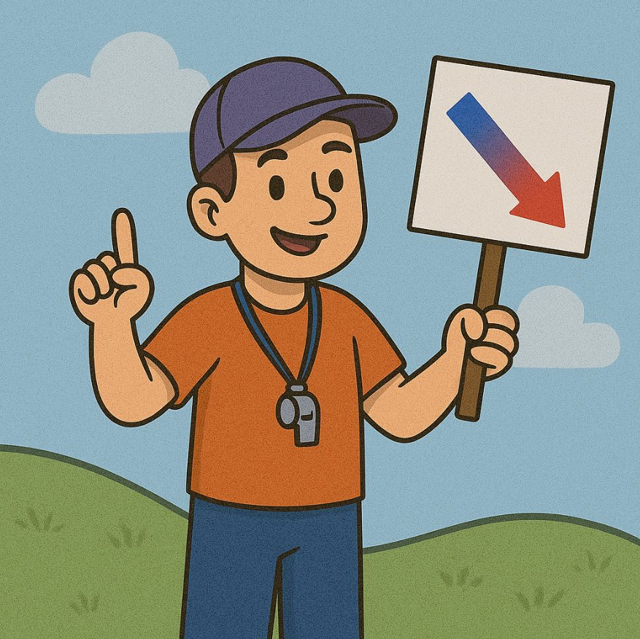
Coach Grad
"The gradient" is just a fancy math word that points in the direction where the hill drops the fastest. If Sam moves opposite that gradient arrow, he travels downhill and lowers the computer’s mistake quickly. As an example: Coach Grad blows a whistle and points Sam down the steepest slope so he can speed toward smaller errors.

Slide 6
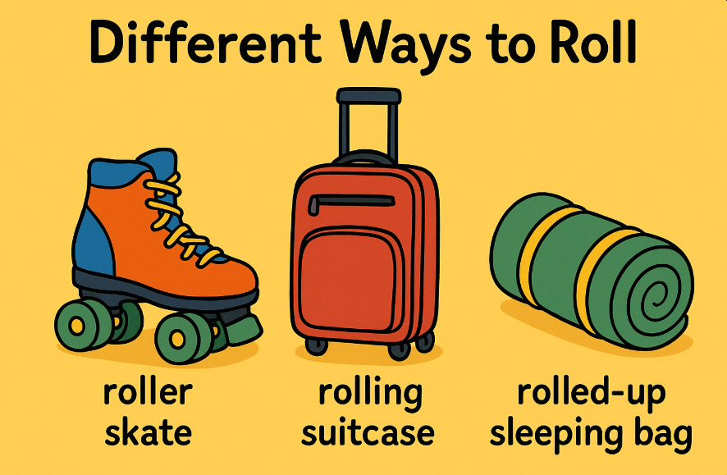
Different Ways to Roll
Each push Sam takes is called a learning rate. If the push is too small, he creeps along and takes forever; if it’s too big, he zooms past the bottom and climbs the hill again. A just‑right push gets him there quickly and safely.
Example: Tiny shuffles make Sam inch forward, while giant leaps shoot him past the Candy Cup; medium pushes land him perfectly in front of it.​

Slide 7
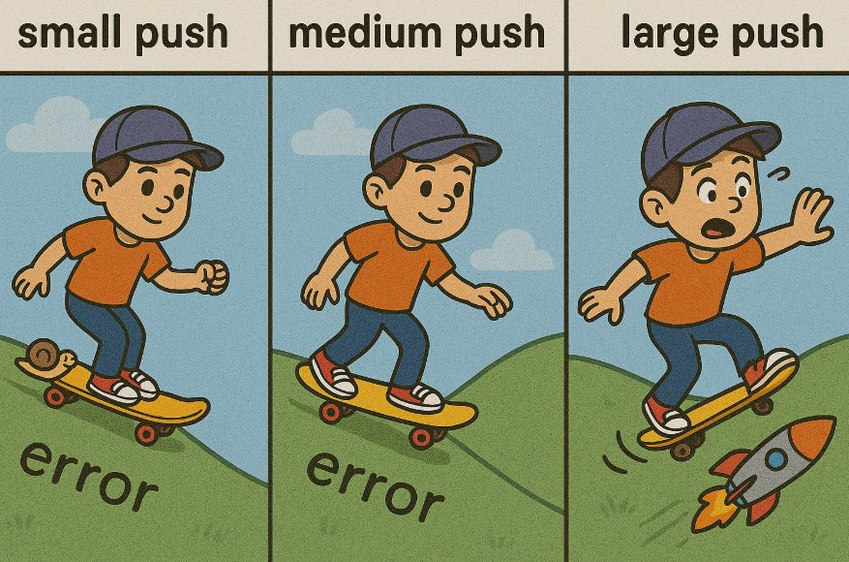
Step Size Matters – Learning Rate
Each push Sam takes is called a learning rate. If the push is too small, he creeps along and takes forever; if it’s too big, he zooms past the bottom and climbs the hill again. A just‑right push gets him there quickly and safely. Tiny shuffles make Sam inch forward, while giant leaps shoot him past the Candy Cup; medium pushes land him perfectly in front of it.

Slide 8
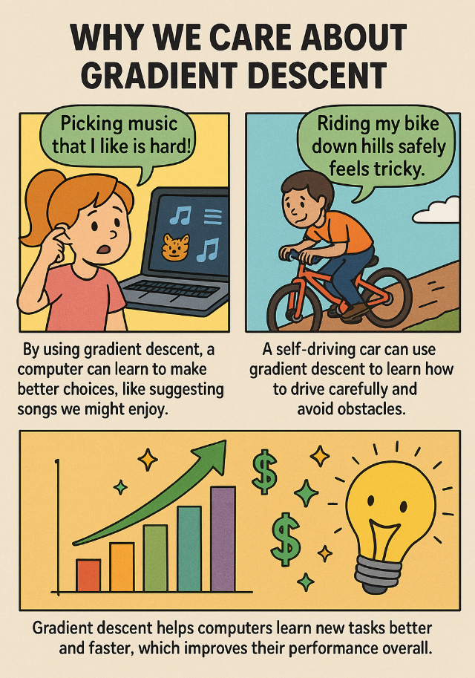
Why We Care
Gradient Descent trains cameras to spot puppies and kittens (remember the basics of recognition patterns).
It teaches smart cars to steer safely, imagine never having to drive again!
And it helps apps pick awesome videos or songs you will love.

